Slide 1
Benevolent Patent Extensions
Chris Barrett
Guest Lecture to ECON 7740
October 21, 2020

Slide 2
Patents: A tool to incentivize R&D
Patents
Inventor investments in R&D involve significant sunk costs (can be a LOT … ~$800mn/ marketed pharmaceutical)
If can’t keep R&D discoveries secret, big externalities.
A patent exchanges public revelation of details of discovery for fixed period of state-enforced temporary monopoly power (right to prevent others’ use of discovery). Resolves externality. Inventor temporarily captures (all?) net gains.
Result: value of discovery is the (expected) monopoly rent arising from the patented product/service. Invest more in R&D than if incur sunk costs then compete post-discovery.

Slide 3
Benevolent discoveries
Patent value low for discoveries w/prospective monopoly rent < R&D cost. One case of particular interest:
Commercial mkt limited by poverty of beneficiary population. Limited mkt in high-income world but big human impacts in poor countries.
Ex: Neglected tropical diseases and disease-based poverty traps:
dengue fever, onchocerciasis, schistosomiasis, trypanosomiasis, etc. affect > 1bn
Orphan crops:
- Cassava, Cowpea, Millets, Plantain, Tef, etc. >100 mn ha (Tadele 2019)
We shall call discoveries for charitable rather than profit purposes ‘benevolent’. (Could also be for, e.g., rare childhood diseases a la Cure Rare Disease - Rich Horgan ‘14)

Slide 4
Benevolent discoveries
Patent incentives elicit few benevolent discoveries. Most BDs are open source discoveries based on public/philanthropic R&D finance.
Exception: incidental, fortuitous discoveries (e.g., eflornithine for trypanosomiasis and hirsutism).
Why rely on lucky discovery of a secondary use?
But massive investment unmet needs for R&D for benevolent purposes. Estimated needs beyond present private and public investment:
$26 bn/year to address hunger (Laborde et al. 2020)
$1bn/year to eliminate NTDs (Fitzpatrick et al. 2017)

Slide 5
Patents: A tool to incentivize R&D
Alternatives to patents
Advanced mkt commitments: GAVI, etc. (Kremer et al. 2020)
- Resulting pneumococcal vaccine saved ~700K lives
Prizes: Napoleon and canning food; Lindbergh and Orteig Prize, Ansari X Prize, etc. (Wagner 2011)
Issues:
Promise keeping (either reneging, or portfolio collapse)
R&D still insufficient even w/AMCs and prizes

Slide 6
Patent extensions
Patent law in the US and other jurisdictions already allows extensions/adjustments has exceptions for extending a patent beyond statutory term (LLOC 2016).
In US, a Patent Term Adjustment allows for extending the term of a U.S. patent if PTO is slow to act on a filing.
Why not allow for adjustment/extension in exchange for benevolent discovery?

Slide 7
BPE: how might it work?
For an invention that is non-obvious, novel, useful and benevolent
In filing for patent, the inventor can request extension of other, existing non-essential patent in exchange for:
Attestation that they will not enforce their patent right (attempting to enforce the patent would then void the patent filing); or
Dedicate to the public the terminal part of the patent term (35 U.S.C. 253(b)).
PTO must assess (i) benevolence of invention, and (ii) non-essentiality of patent to be extended. If both criteria satisfied, then BPE request granted.

Slide 8
What is non-essential?
Only ‘non-essential’ patents eligible for extension.
Any patent essential to maintain healthy, free life (e.g., no vaccines, life-saving devices/drugs, transport safety equipment, etc.) ineligible for extension.
Examples of eligible patents: business software, sporting goods, leisure and entertainment goods and designs, male baldness treatments, etc.
Target: high-value luxury lifestyle products/designs
(ideally very income elastic / very price elastic demand)

Slide 9
Key implications
Value boost: Benevolent patent valued based on market for extended patent, not on benevolent discovery’s direct mkt value. Many non-essential patents return $100s mn/yr.
Voluntary: No inventor obliged to surrender patent rights.
Inventor still gets the patent but cannot enforce. Generic competitors can produce/sell benevolent discovery.
Who is potentially made worse off? (i)Generic producers who would enter at patent expiration; (ii) Purchasers of patented product beyond original expiration. Both are voluntary … no one compelled to buy nor to enter and compete
Prospective investors: non-practicing entities; cash-rich digital tech firms; firms needing image boost.

Slide 10
Possible benefits
Induced R&D capacity in Global South:
Benevolent discoveries may require in situ R&D: Subject populations for human trials; agroecological conditions for crop trials; etc.
Encourage investment in R&D facilities and human capital: Much of Global South deficient in both.
If a big tech firm wants to extend app patent, a strategy becomes to invest in labs in LICs.

Slide 11
Possible benefits
Restorative justice:
∂WTP/∂Wealth > 0 : Commercial market potential for a discovery arises (partly) due to wealth differences.
Why do wealth inequalities exist? At least in part due to prior generations’ transgressions: colonial extraction, slavery, proxy wars, etc.
BPEs offer a fully voluntary mechanism to tap the fruits of (partially) ill-gotten wealth to address the charitable needs of its victims.
Partially repair the harm caused by past damages done: an indirect tool for restorative justice? No aid required.

Slide 12
Next steps
Write up idea as article
Draft legislation: amend Title 35 of US Code

Slide 13
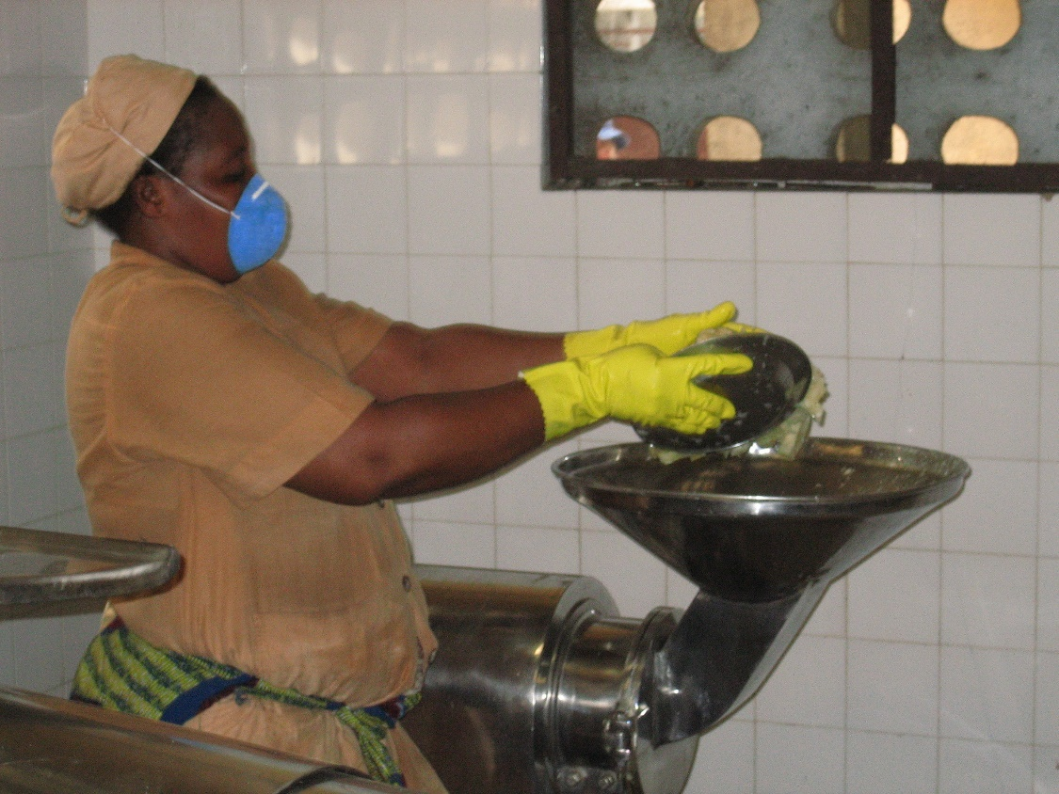
Thank you
Thank you for your interest
I invite your comments

